Slide 1
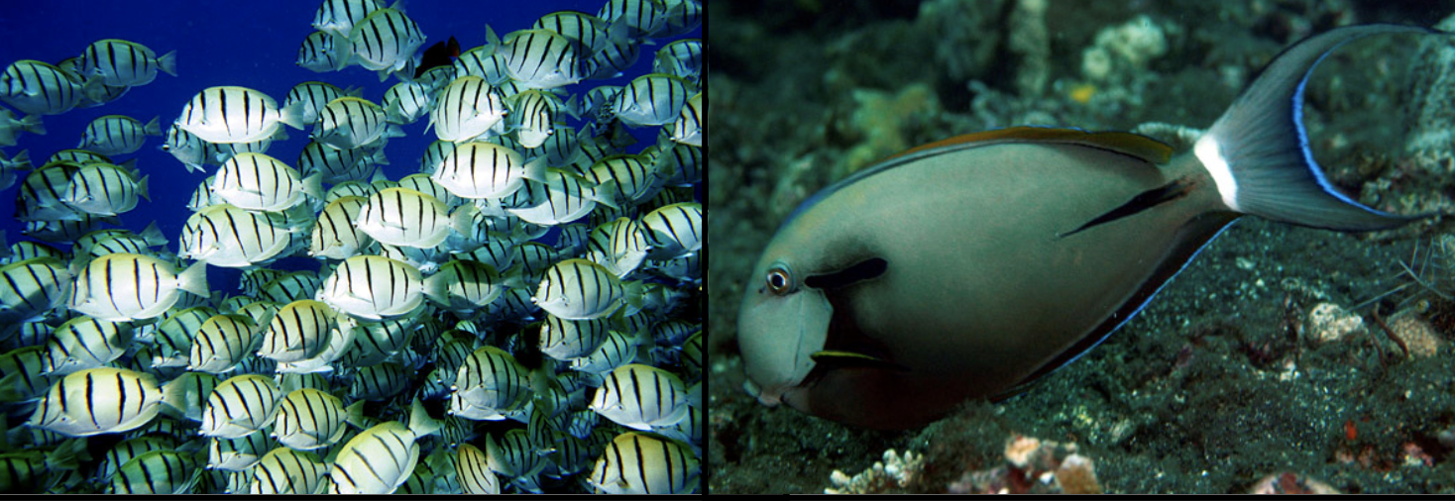
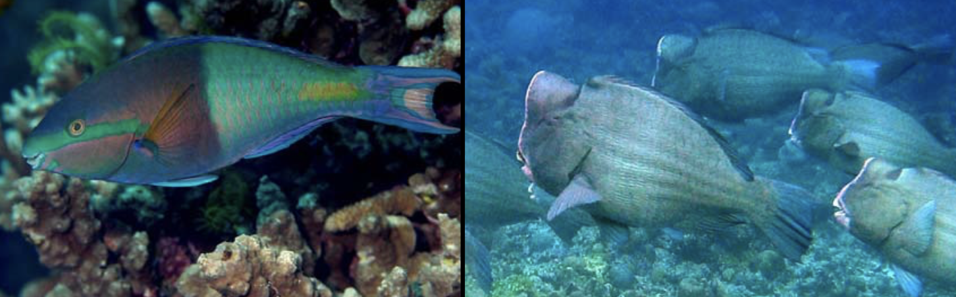
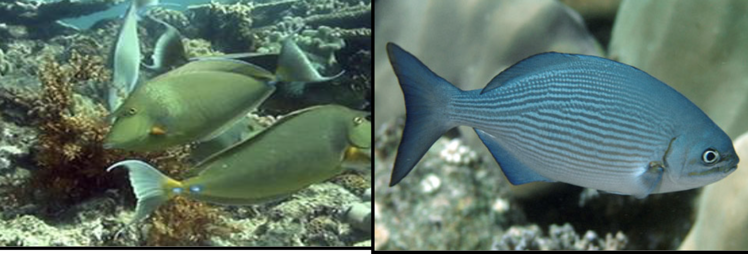
Grazing gradients: open science project
Grazers/croppers
Control cover of turf/algal mats
Scrapers/excavators/bioeroders
Bioerosion: Remove turf + coral substrate
Browsers
Macroalgal feeders

Slide 2
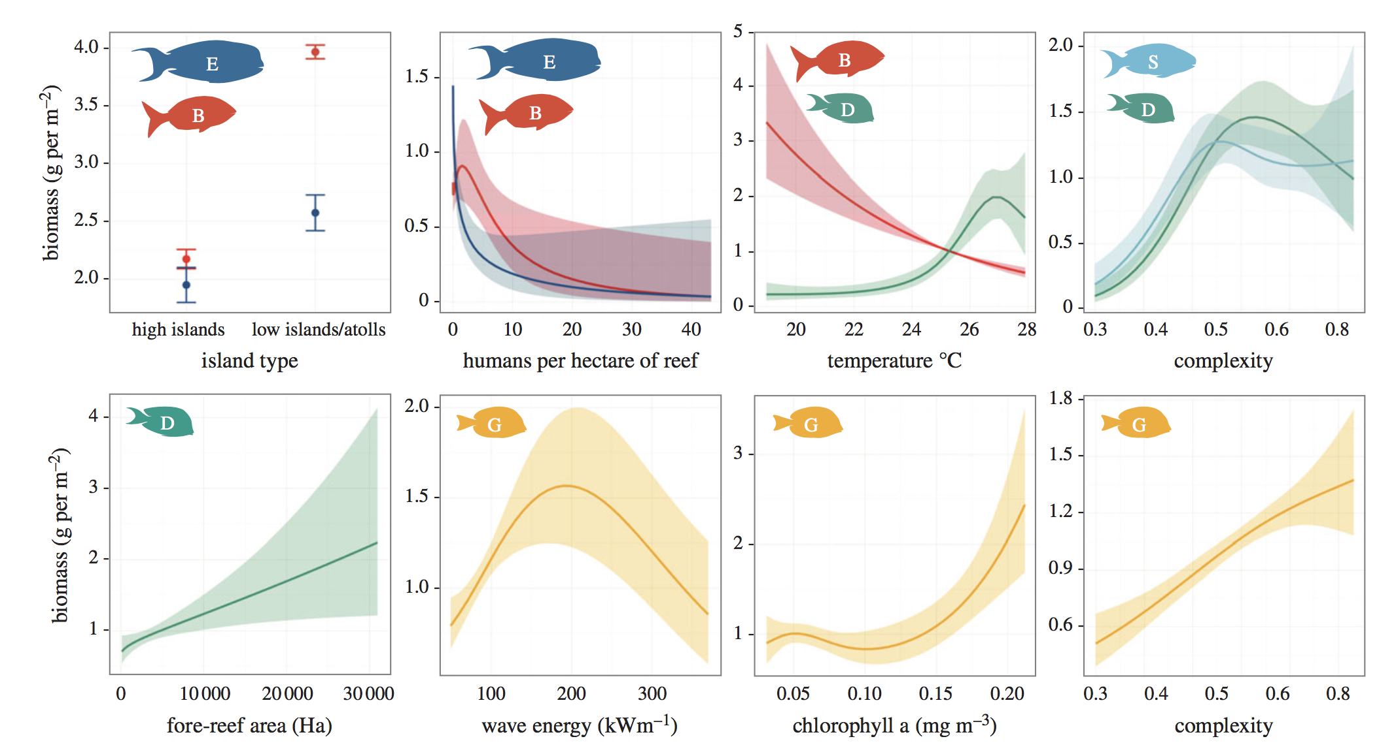
Herbivore assemblage composition is influenced by natural and human drivers
Coral bleaching?
Heenan et al. 2016

Slide 3
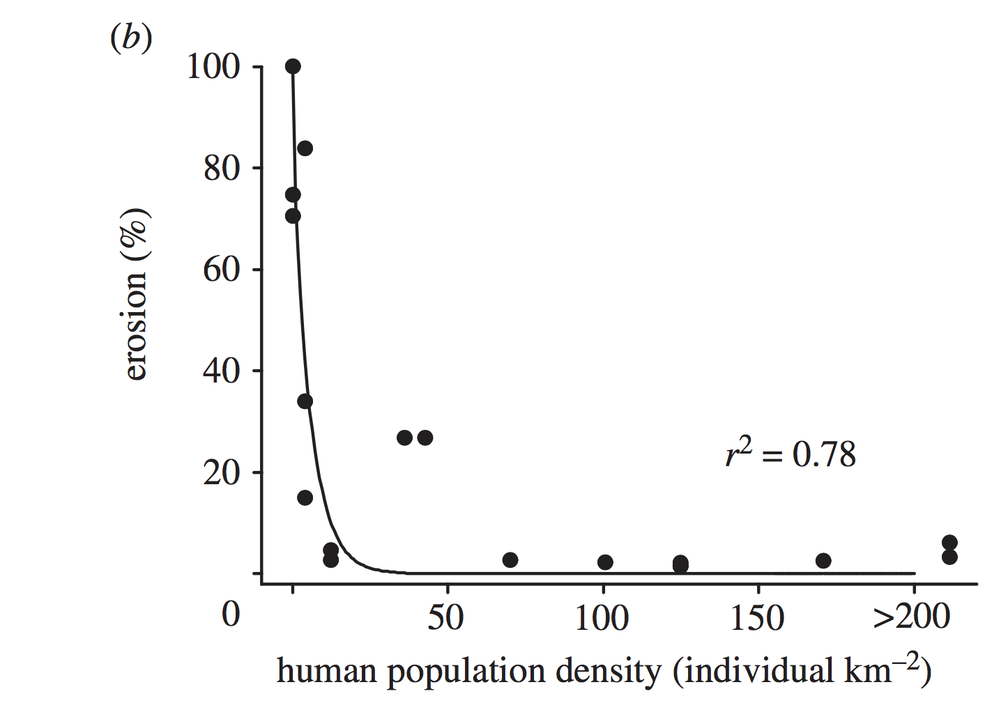
Herbivore bioerosion function disappears along a fishing gradient:
Scarid + Chlorurus species
Grazer biomass at 18 Indo-pacific reefs
Biomass-weighted bite rates & bite volumes
Accounts for effect of species compositional shifts within feeding groups BUT
Contribution of other important herbivore species unknown
Bellwood et al. 2011

Slide 4
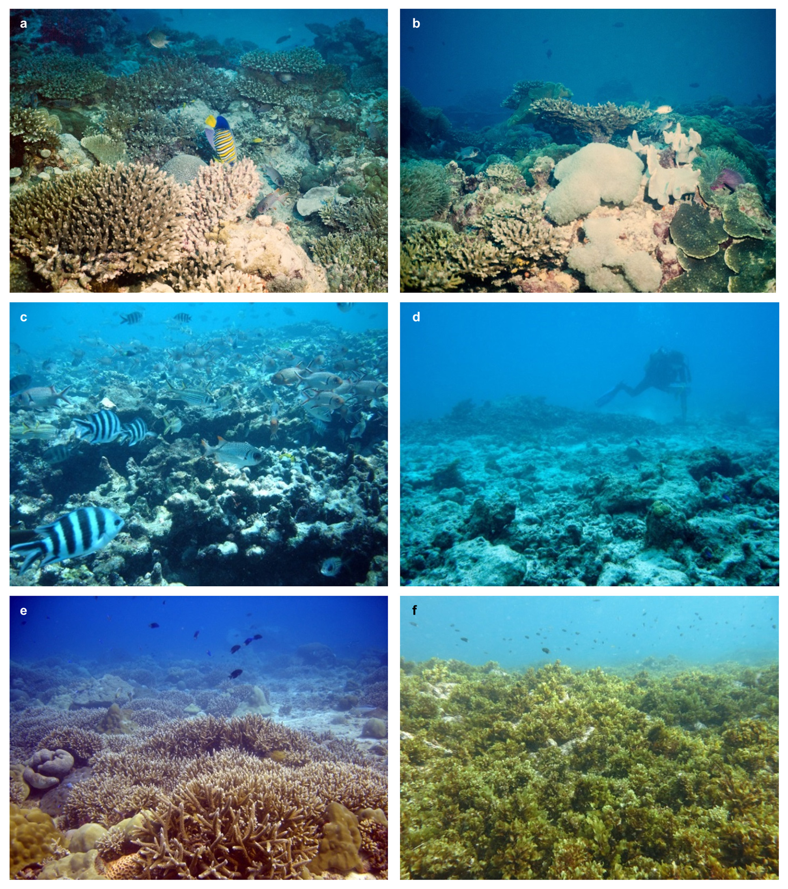
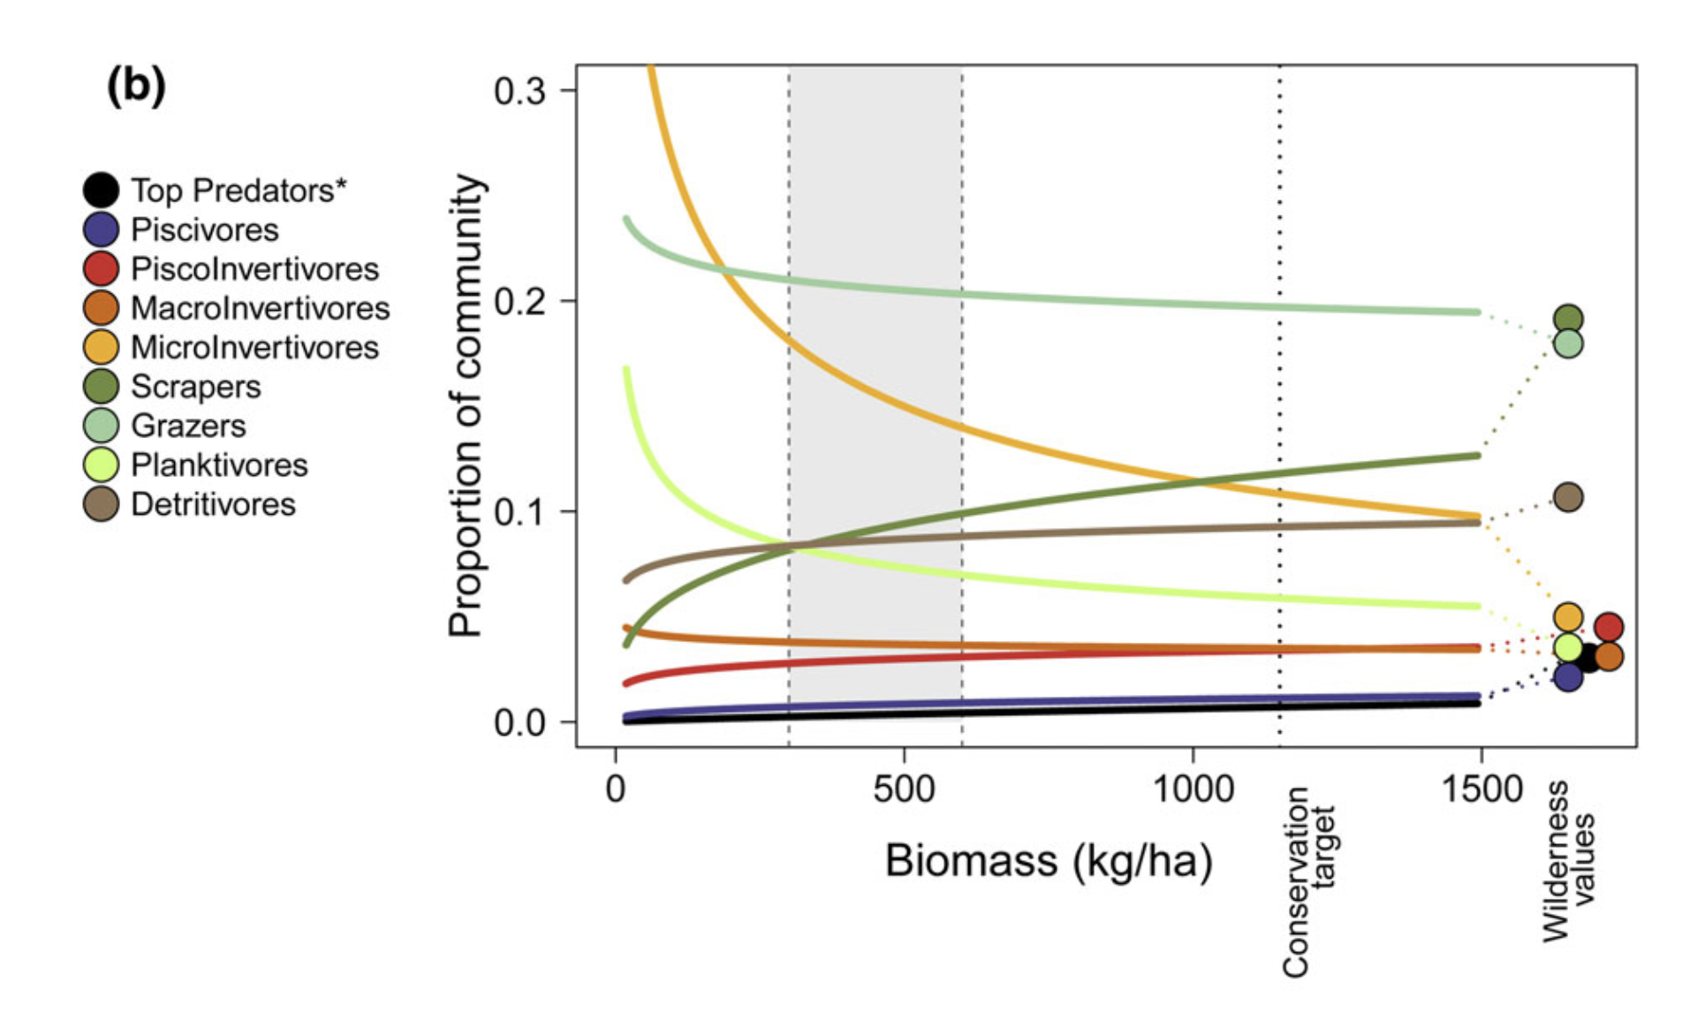
How does grazing function change along fishing and habitat gradients?
3 functions: Turf removal by grazers; bioerosion by scrapers; macroalgal consumption by browsers
Bleaching events
Fishing effects
McClanahan et al. 2015

Slide 5
Data requirements:
Herbivore biomass across reefs of varying fish biomass and benthic condition
Nick’s UVC data = Seychelles, Maldives, GBR, Chagos
Published bite rates for herbivore species/families
Several papers on this (Goatley, Bejarano, Bellwood, Marshell)
Confounding explanatory variables – depth, temperature, reef zone??
If, grazing function = UVC biomass * bite rate, summed across species
Grazing function ~ habitat + fishable biomass + temperature + depth….+??
Collaborative project,
working by open science principles (why?),
and using INCREDIBLY USEFUL tools such as….

Slide 6
Open data
Faster research, better research, more ideas, more collaboration
Reproducibility
Robust + efficient research between collaborators: version control (Github), reproducible documents (Rmarkdown)
Open access
‘future you’
Bigger academic + societal impact, potential for uptake by researchers & policymakers in developing countries

Slide 7
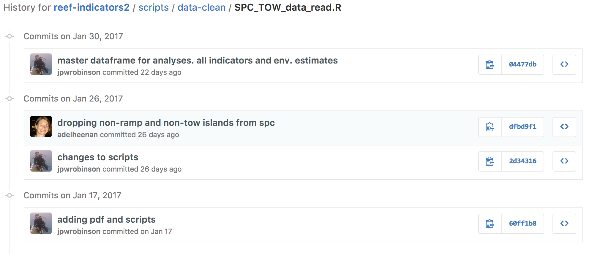
Github
No loss of data or scripts
shows progress
can track issues
fully reproducible
Easy to collaborate

Slide 8
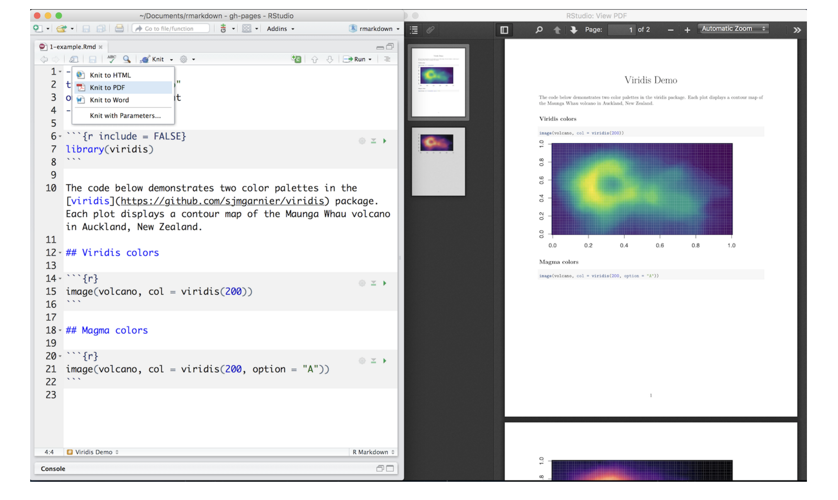
Reproducible reports
Lets your analysis evolve
Collaborative potential
Divide & conquer (science)
R-markdown
R-markdown

Slide 9
Timeline*
Weekly meetings?
May:
Learning OS tools - version control, Rmarkdown
Cleaning + discussing UVC data
Lit review to extract bite rate estimates
June:
Data exploration + analysis
1st R-markdown report (methods, exploratory results)
Present idea to group/David Mouillot?
July:
Honing results, figures, statistics
2nd R-markdown report (methods first draft)
Aug:
Final figures + results
3rd R-markdown report (methods, results, figures, tables)
Drafting introduction, discussion
Sept:
Present to lab group.
4th R-markdown report as Final version (converted to Word doc for Nick….)
Submit to an open access journal!
*Obviously good idea to have discussion about roles here, re: lit. reviews, data cleaning, statistics, writing…??
**Also aware that people have field work, conferences, holidays…

